Slide 1
Chapter 14: Internal and External Memory
Programming and Expansion
The PIC18 Microcontroller
Han-Way Huang
Minnesota State University, Mankato
June 2004

Slide 2
PIC18 Memory System
Has three internal memory blocks:
1. Program memory (EPROM or flash memory)
2. Data memory (SRAM)
3. Data EEPROM
High pin count (mostly 80 pins) PIC18 members also support external memory
External memory can be SRAM, EPROM, EEPROM, or flash memory.
On-Chip Flash Program Memory
A read from the program memory (using table read instruction) is one byte at a time.
A write to the program memory is executed on one block of eight bytes at a time.
On-chip program flash memory is erased in a block of 64 bytes at a time.
The on-chip program flash memory is 16 bits wide.
Writing and erasing program flash memory is much longer than one instruction cycle, it will stop instruction fetching until the operation is complete.

Slide 3
Control Registers of Program Flash Memory
EECON1
EECON2
TABLAT
TBLPTR
EECON1 and EECON2 Registers
EECON1 controls the access of program flash memory and data EEPROM.
EECON2 is not a physical memory but is used in the program memory erasing and writing.
The contents of the EECON1 register are shown in Figure 14.1

Slide 4
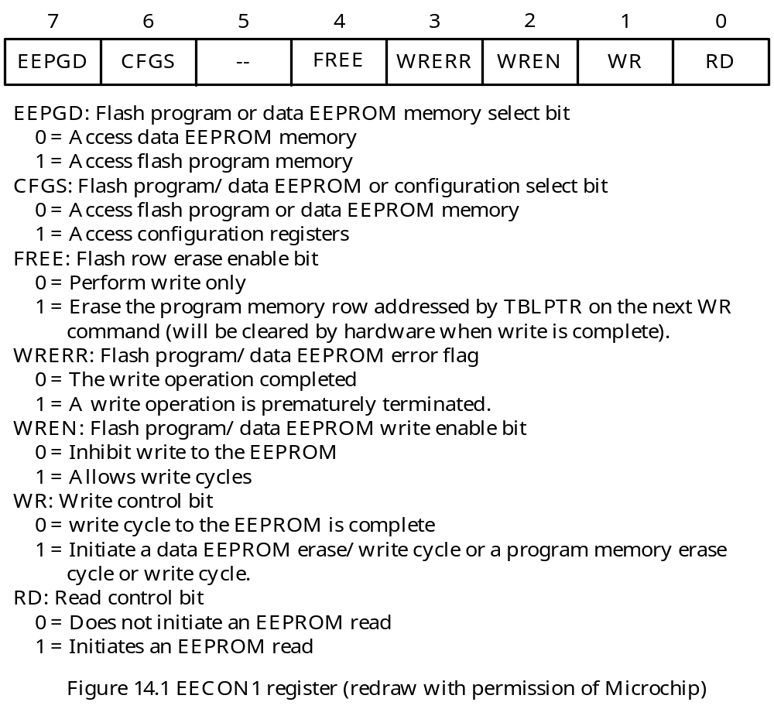

Slide 5
The EEPGD bit determines whether the access is to the program memory or the data EEPROM.
The CFGD bit determines whether the access is to the configuration/calibration registers (when equals 1) or to the program memory/data memory (when equals 0).
The FREE bit must be set to 1 in order to erase the flash program memory.
The WREN bit enables/disables the write operation to the flash memory.
The WRERR bit will be set to 1 when a write operation is interrupted by a MCLR reset or a WDT time-out reset.

Slide 6
Erasing Flash Program Memory
Only a block of 64 bytes can be erased in one operation by executing a special instruction sequence.
The most significant 16 bits of the TBLPTR register (TBLPTR<21:6>) select the block to be erased.
The lowest six bits of the TBLPTR register are ignored.
To erase a block of locations in flash memory, the following bits of the EECON1 register must be set to 1:
1. EEPGD
2. WREN
3. FREE
The flash memory starts a long write operation when an erase operation is started.
The long write operation will be terminated by the internal programming timer.

Slide 7
Sequence of Events Occurred during an Erase Operation
Load the table pointer with the address of the row to be erased.
Set the EEPGD, WREN, and FREE bits of the EECON1 register to 1s for the erase operation. Clear the CFGS bit to select the flash memory.
Disable interrupts.
Write the value of 0x55 to the EECON2 register.
Write the value of 0xAA to the EECON2 register.
Set the WR bit of the EECON1 register to 1 to start the erase operation.
The CPU stalls for the duration of the erase cycle (about 2 ms using internal timer).
Execute a NOP instruction.
Re-enable interrupts.

Slide 8
Instruction Sequence to Erase the Row with the Label row_era:
movlw upper row_era ; load TBLPTR with the value represented
movwf TBLPTRU,A ; by the label row_era
movlw high row_era ; “
movwf TBLPTRH,A ; “
movlw low row_era ; “
movwf TBLPTRL,A ; “
bcf EECON1,CFGS,A ; select flash program memory
bsf EECON1,EEPGD,A ; point to flash program memory
bsf EECON1,WREN,A ; enable write to flash memory
bsf EECON1,FREE,A ; enable erase operation
bcf INTCON,GIE,A ; disable interrupts
movlw 0x55
movwf EECON2,A
movlw 0xAA
movwf EECON2,A
bsf EECON1,WR,A ; start erase operation (CPU stall)
nop
bsf INTCON,GIE,A ; re-enable interrupts

Slide 9
Writing to Flash Program Memory
Minimum programming unit for the flash memory is eight bytes.
One needs to copy the data to be programmed into eight holding registers in the flash memory.
Executes a special required instruction sequence (to be shown shortly) and then sets the WR bit of the EECON1 register to start the write operation.
To program the flash memory (or EEPROM) correctly, the locations to be programmed must be erased before being programmed.
The block size for erasure (64 bytes) and the block size for programming (8 bytes) are different.
To program correctly, perform the following operations:
1. Copy the 64-byte block that contains the 8-byte block to be programmed into a buffer.
2. Write the block of data to be programmed into the flash memory into the appropriate 8-byte block in the buffer.
3. Erase the flash memory block.
4. Program the whole 64-byte buffer block into the corresponding flash memory block.

Slide 10
The 64-byte block to be erased are 2⁶-byte aligned; i.e., the hardware ignored the lowest six address bits when choosing the memory block to be erased.
The eight bytes to be programmed may straddle two 64-byte blocks.
To test if these 8 bytes straddle two aligned 64-byte block,
Add 7 to the starting address of the flash memory to be programmed. If after addition, the lowest 6 bits of the sum are less than 7, then the 8-byte block straddles two 64-byte aligned block.
To program 8 bytes of flash memory locations that are not contained in a single 64- byte aligned block, one must proceed as follows:
1. Divide these 8 bytes into two blocks with each contained in a 64-byte aligned block.
2. Program these two blocks separately.

Slide 11
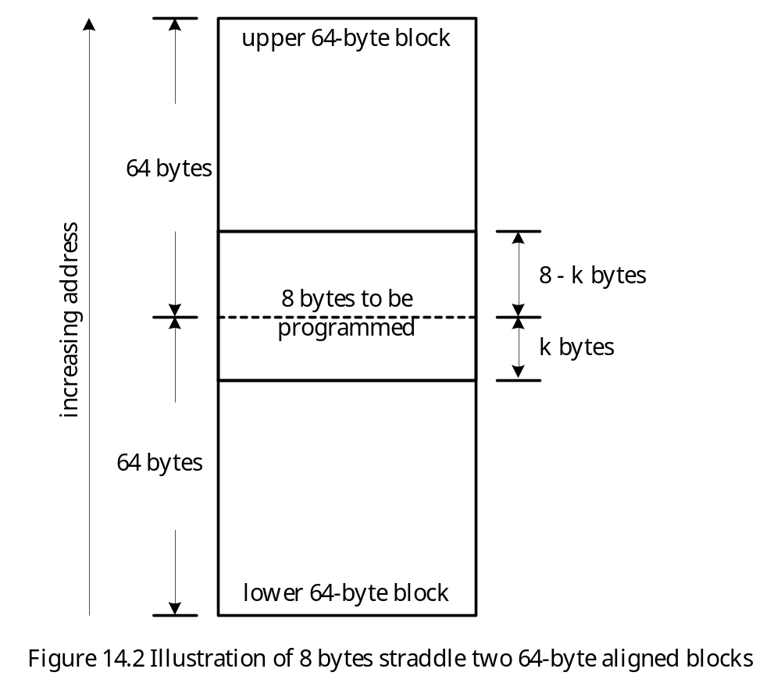

Slide 12
Example 14.1 Write a subroutine that programs k bytes (1 ≤ k ≤ 8) of data into the flash memory starting from the specified address. The k bytes of values to be programmed and the starting address of the flash memory are pushed onto the stack. These k bytes are contained in a 2⁶-byte aligned block.
Solution:
This subroutine uses software stack to perform the required operation.
The stack frame is shown in Figure 14.3.

Slide 13
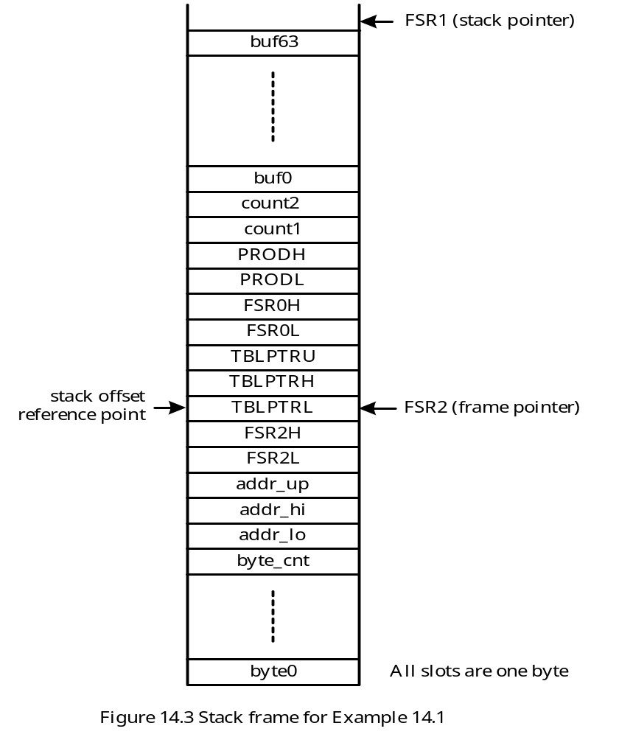

Slide 14
#include <p18F8680.inc>
byte_cnt equ -6 ; offset of byte_cnt from the frame pointer
addr_lo equ -5 ; offset of addr_lo from the frame pointer
addr_hi equ -4 ; offset of addr_hi from the frame pointer
addr_up equ -3 ; offset of addr_up from the frame pointer
count1 equ 7 ; offset of count1 from the frame pointer
count2 equ 8 ; offset of count2 from the frame pointer
buf0 equ 9 ; offset of buf0 from the frame pointer
loc_var equ 66 ; size of local variables
pushr macro arg ; macro to push the arg register into stack
movff arg,POSTINC1
endm
popr macro arg ; macro to pop the arg register from stack
movff POSTDEC1,arg ; decrement the stack pointer
movff INDF1,arg ; pop off a byte from the stack onto arg
endm
alloc_stk macro n ; this macro allocates n bytes in stack
movlw n
addwf FSR1L,F,A
movlw 0x00
addwfc FSR1H,F,A
endm

Slide 15
dealloc_stk macro n ; this macro deallocate n bytes from stack
movlw n
subwf FSR1L,F,A
movlw 0x00
subwfb FSR1H,F,A
endm
org 0x00
goto start
org 0x08
retfie
org 0x18
retfie
start lfsr FSR1,0xE00 ; set up software stack pointer
movlw 0x31 ; push values (1,..,8) to be programmed
pushr WREG ; "
incf WREG,W,A ; "
pushr WREG ; "
incf WREG,W,A ; "
pushr WREG ; "
incf WREG,W,A ; "
pushr WREG ; "

Slide 16
incf WREG,W,A ; "
pushr WREG ; "
incf WREG,W,A ; "
pushr WREG ; "
incf WREG,W,A ; "
pushr WREG ; "
incf WREG,W,A ; "
pushr WREG ; "
movlw 0x08 ; push byte count
pushr WREG ; “
movlw low addr ; push address of flash memory to be
pushr WREG ; programmed
movlw high addr ; "
pushr WREG ; "
movlw upper addr ; "
pushr WREG ; "
call prog_flash ; call subroutine program flesh memory
dealloc_stk 12 ; clean up the allocated stack space
forever nop ; infinite loop
bra forever ; "

Slide 17
; ********************************************************************
; The following subroutine programs 1 to 8 bytes of values into flash
; program memory. The memory locations to be programmed are contained in
; one aligned 64-byte block. The values to be programmed, the byte count,
; and the starting address to be programmed are pushed into the stack.
; ********************************************************************
prog_flash pushr FSR2L ; save caller's frame pointer
pushr FSR2H ; "
movff FSR1L,FSR2L ; set up new frame pointer
movff FSR1H,FSR2H ; "
pushr TBLPTRL ; save table pointer
pushr TBLPTRH ; "
pushr TBLPTRU ; "
pushr FSR0L ; save FSR0
pushr FSR0H ; "
pushr PRODL ; save PRODL
pushr PRODH ; save PRODH
alloc_stk loc_var ; allocate local variable space
movf FSR2L,W,A ; set FSR0 to point to the start of the buffer
addlw buf0 ; in the stack frame
movwf FSR0L,A ; "
movlw 0 ; "

Slide 18
addwfc FSR2H,W,A ; "
movwf FSR0H,A ; "
movlw addr_lo ; set TBLPTR to point to the start of the
movf PLUSW2,W ; 64-byte aligned block to be saved
andlw 0xC0 ; "
movwf TBLPTRL,A ; "
movlw addr_hi ; "
movff PLUSW2,TBLPTRH ; "
movlw addr_up ; "
movff PLUSW2,TBLPTRU ; "
; back up the 64-byte block first
movlw 64
movwf PRODL,A
cpy_lp1 tblrd*+ ; read one byte from program memory
movff TABLAT, POSTINC0 ; into TABLAT and transfer to the buffer
decfsz PRODL,F,A ; "
bra cpy_lp1 ; "
; set up offsets in buffer and data in stack for modifying buffer
movlw byte_cnt ; place the number of bytes to be modified in
movff PLUSW2,PRODH ; PRODH (also used as loop count)
movlw addr_lo ; find out the offset in stack frame to
movf PLUSW2,W ; be modified by programming data and

Slide 19
andlw 0x3F ; leave it in count2
addlw buf0 ; "
movwf PRODL,A ; "
movlw count2 ; "
movff PRODL,PLUSW2 ; "
movf PRODH,W,A ; place byte count in WREG
sublw byte_cnt ; compute the stack offset of byte0 from FSR2
movwf PRODL,A ; and leave it in count1
movlw count1 ; "
movff PRODL,PLUSW2 ; "
; write k bytes (k = 1..8) of data into the buffer before performing flash programming
mdy_lp movlw count1
movf PLUSW2,W ; get the offset into WREG
movff PLUSW2,PRODL ; place the programming data in PRODL
movlw count2 ; find the offset of the buffer slot to be
movf PLUSW2,W ; modified
movff PRODL,PLUSW2 ; replace buffer value with programming data
movlw count1 ; increment the offset
incf PLUSW2,F ; "
movlw count2 ; "
incf PLUSW2,F ; "
decfsz PRODH,F,A ; are k bytes all written in buffer?

Slide 20
bra mdy_lp ; "
; erase the flash memory block
movlw addr_lo
movff PLUSW2,TBLPTRL
movlw addr_hi
movff PLUSW2,TBLPTRH
movlw addr_up
movff PLUSW2,TBLPTRU
bsf EECON1,EEPGD,A ; point to flash memory
bcf EECON1,CFGS,A ; access flash program memory
bsf EECON1,WREN,A ; enable write to flash memory
bsf EECON1,FREE,A ; enable flash erase
bcf INTCON,GIE,A ; disable interrupts
movlw 0x55 ; required sequence
movwf EECON2 ; "
movlw 0xAA ; "
movwf EECON2 ; "
bsf EECON1,WR,A ; start erase (CPU stall)
bsf INTCON,GIE ; re-enable interrupt
; perform flash programming and set up two layer of loops, each 8 times
movlw 8 ; set outer loop count to 8
movwf PRODL,A

Slide 21
movlw count1
movff PRODL,PLUSW2
movf FSR2L,W,A
addlw buf0
movwf FSR0L,A
movlw 0
addwfc FSR2H,W,A
movwf FSR0H,A
prog_loop movlw 8 ; set inner loop count to 8
movwf PRODL,A ; "
movlw count2 ; "
movff PRODL,PLUSW2 ; "
write_wd movf POSTINC0, TABLAT ; copy one byte to the holding register
tblwt*+ ; until buffers are full
movlw count2 ; “
decfsz PLUSW2,F,A ; “
bra write_wd ; “
bsf EECON1,EEPGD,A ; point to flash memory
bcf EECON1,CFGS,A ; access flash program memory
bsf EECON1,WREN,A ; enable write to memory
bcf INTCON,GIE,A ; disable interrupt
movlw 0x55 ; required sequence

Slide 22
movwf EECON2 ; "
movlw 0xAA ; "
movwf EECON2 ; "
bsf EECON1,WR,A ; start programming (CPU stall)
nop
bsf INTCON,GIE,A ; enable interrupts
movlw count1 ; decrement outer loop count
decfsz PLUSW2,F,A ; "
bra prog_loop ; loop until done
bcf EECON1,WREN,A ; disable write to memory
done dealloc_stk loc_var
popr FSR0H
popr FSR0L
popr TBLPTRU
popr TBLPTRH
popr TBLPTRL
popr FSR2H
popr FSR2L
return 0
addr org ($+0x3F) & 0x1fffc0 ; force to align with 64-byte boundary
data 0x41,0x42,0x43,0x44
data 0x45,0x46,0x47,0x48
end

Slide 23
Data EEPROM Memory
Readable and writable.
Not directly mapped in the register file space.
Indirectly addressed through the special function registers.
Five registers are involved in reading and writing of the data EEPROM.
1. EECON1
2. EECON2
3. EEDATA
4. EEADRH
5. EEADR
Allows byte read and byte write operations.
Data to be written is placed in EEDATA whereas the address of the location to be programmed is placed in EEADRH and EEADR.
PIC18 devices with 256 bytes of data EEPROM do not have EEADRH.

Slide 24
Reading the Data EEPROM Memory
1. Write the address into the EEADRH:EEADR (or EEADR for devices with 256 bytes of EEPROM)
2. Clear the EEPGD bit of the EECON1 register.
3. Clear the CFGS bit of the EECON1 register.
4. Set the RD bit of the EECON1 register
Instruction Sequence to Read an EEPROM Byte
movlw high eedata_loc ; set up upper address bits of EEPROM
movwf EEADRH,A ; data memory for reading
movlw low eedata_loc ; set up lower address byte of EEPROM
movwf EEADR,A ; data memory for reading
bcf EECON1,EEPGD ; point to EEPROM data memory
bcf EECON1,CFGS ; access EEPROM
bsf EECON1,RD ; read data EEPROM
movf EEDATA,W ; place data in WREG

Slide 25
Writing to the Data EEPROM Memory
Place the address in the EEADRH:EEADR register pair.
Place data in the EEDATA register.
Execute the following instruction sequence:
movlw high eedata_loc ; set up address of data EEPROM
movwf EEADRH,A ; to be written
movlw low eedata_loc ; “
movwf EEADR,A ; “
movlw ee_val ; place data to be written in EEDATA
movwf EEDATA,A ; “
bcf EECON1,EEPGD,A ; point to data memory
bcf EECON1,CFGS,A ; access data EEPROM
bsf EECON1,WREN,A ; enable write to data EEPROM
bcf INTCON,IE,A ; disable interrupt
movlw 0x55 ; required sequence
movwf EECON2,A ; “
movlw 0xAA ; “
movwf EECON2,A ; “
bsf EECON1,WR,A ; start write operation
bsf INTCON,GIE,A ; re-enable interrupt
… ; other user instructions
… ; “
bcf EECON1,WREN ; disable writes on write complete

Slide 26
PIC18 External Memory Interface
The PIC18F601/801 and PIC18F8XXX devices support external memory.
Up to 2 MB external memory is supported.
PIC18 Program Memory Modes
1. Microprocessor (MP)
2. Microprocessor with Boot Block (MPBB)
3. Extended Microcontroller (EMC)
4. Microcontroller
These modes are programmed by setting the bit 1 and bit 0 of the CONFIG3L register.
The Microprocessor mode allows access only to external program memory.
The MPBB mode allows access on-chip flash memory within only the boot block. The boot block is either 512 bytes or 2KB.
The microcontroller mode accesses only the on-chip flash memory.
The EMC mode allows access to both the internal and the external program memories as a single block.

Slide 27
PIC18 External Memory Pins
- The external memory interface uses between 26 and 38 pins.
Only the external memory interface of the PIC18F8XXX devices will be discussed.
The external memory interface can be enabled or disabled.
The default read cycle (using the table read instruction) to the external memory takes one instruction cycle time (TCY).
The user can extend the external table read and table write cycles by up to 3 instruction cycle times.
The PIC18F8XXX EMI supports three different TBLWRT operations modes: word-write, byte-select, and byte-write modes.
Instruction fetch always take one instruction cycle time to complete.
The operation of external memory is controlled by the MEMCON register.

Slide 28
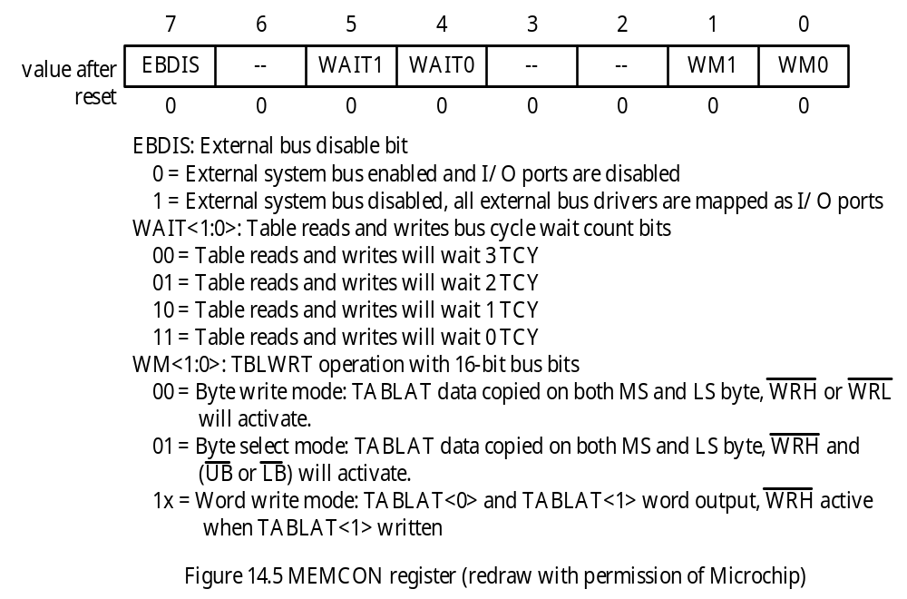
The MEMCON Register

Slide 29
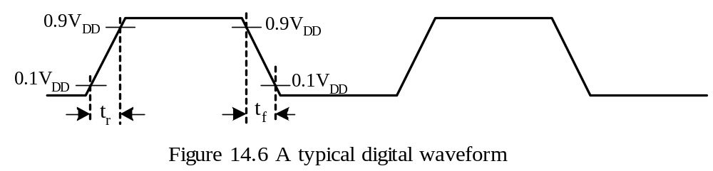
Waveforms of Bus Signals
- The waveform of a typical digital signal is shown in Figure 14.6.
The rise time (t_{r}) of a signal is the time needed for a signal to rise from 10% of the power supply voltage to 90% of the power supply voltage.
The fall time (t_{f}) of a signal is the time needed for a signal to drop from 90% of the power supply voltage to 10% of the power supply voltage.

Slide 30
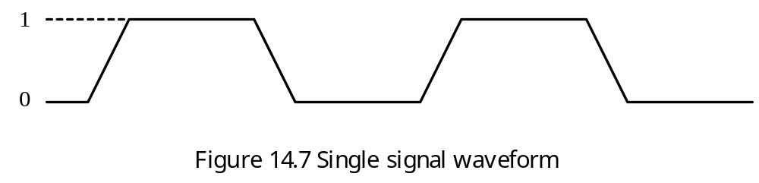
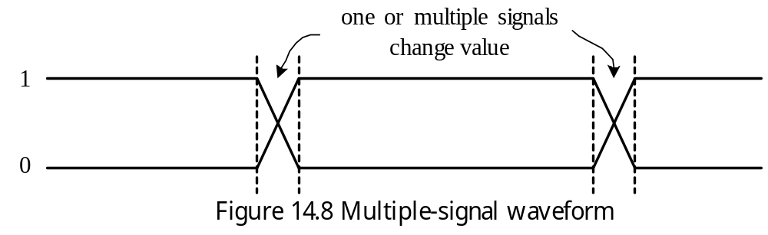
Single Bus Signal Waveform
Multiple-Signal Waveform

Slide 31
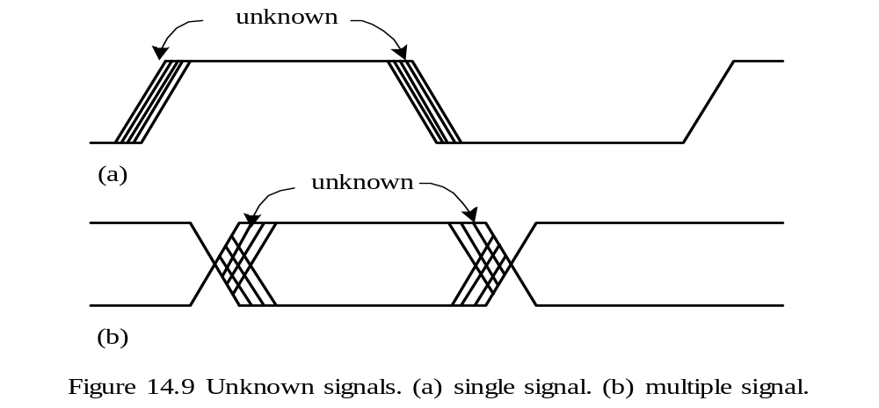
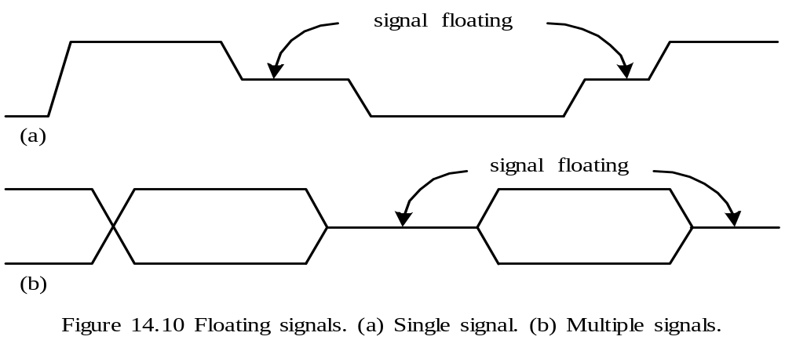
Unknown Signal
Floating Signals

Slide 32
Categories of Bus Signals
Address
Data
Control
Bus Transactions
Includes sending the address and receiving or sending the data
A read transaction (also called read bus cycle) transfers data from memory to either the CPU or the I/O device.
A write transaction (also called write bus cycle) writes data to the memory.
In a read transaction, the address is first send down the bus to the memory, together with the appropriate control signals indicating a read.
The memory responds by placing the data on the bus and asserting a control signal to indicate that the data is valid.
A read bus transaction is shown in Figure 14.11.
In Figure 14.11, a read cycle takes one clock cycle to complete. If necessary, the memory system can delay the assertion of the Ready signal.

Slide 33
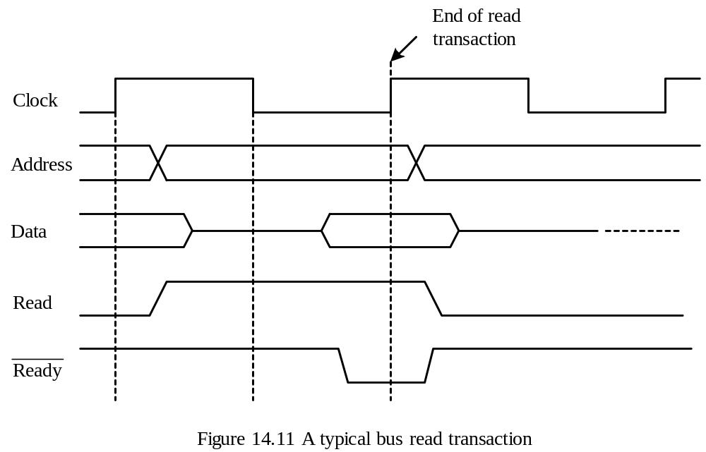

Slide 34
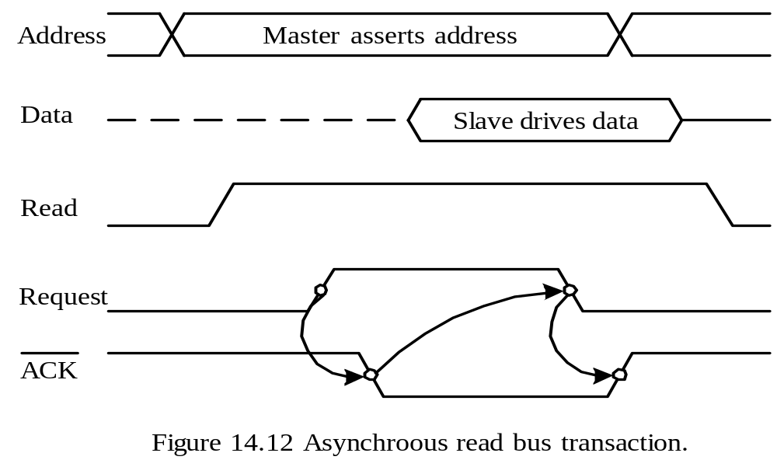
Terminology
1. Bus Master. A device that can generate address and control signals during a bus transaction.
2. Bus Slave. A device such as a memory chip that can only respond to the bus transaction.
3. Synchronous bus. A bus that uses a clock signal to synchronize bus transactions.
4. Asynchronous bus. A bus that does not use a clock signal to synchronize the bus transaction.

Slide 35
Bus Multiplexing
Used to minimize the number of pins used in a chip.
Address bus and data bus are often multiplexed.
Address signals must be stable throughout the whole bus transaction cycle.
In a multiplexed bus system, external circuit must be used to latch the address signals to make them stable through out the whole bus cycle.
PIC18F8XXX External Memory Functions
The data lines D15:D0 and the address lines A15:A0 are multiplexed on port D and port E pins.
The highest four address signals are not multiplexed.
The address signals A19:A0 together select a 16-bit word.
When accessing to the individual byte is needed, the BA0 pin provides the selection.
Depending on the type of access, the BA0 pin is driven by either the least significant bit of the program counter or the least significant bit of the table pointer.
Seven control signals are involved in the bus transaction: OE, WRH, WRL, CE, UB, LB, and ALE.
The signal UB and LB are used to select the upper byte and lower byte.

Slide 36
Program Fetches
The PIC18 fetches a 16-bit instruction in one instruction cycle.
The maximum f_{OSC} for external memory access is 25 MHz at the timing of this writing. This frequency will be increased to 40 MHz for new devices.
The program memory read cycle timing is shown in Figure 14.13.
The values of PC<20:17> and PC<16:1> are driven into pins A<19:16> and A<15:0>, respectively.
During the Q1 cycle, the ALE signal is enabled. The falling edge of ALE occurs slightly after the falling edge of Q2.
The CE signal goes low slightly after the rising edge of the Q2 cycle.
Slightly after the start of the Q3 cycle, the OE signal is asserted to enable program memory to output data to the data bus.

Slide 37
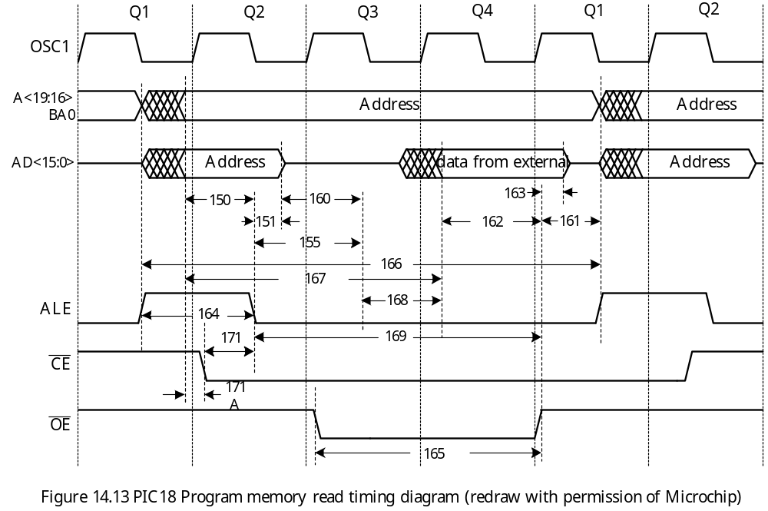

Slide 38
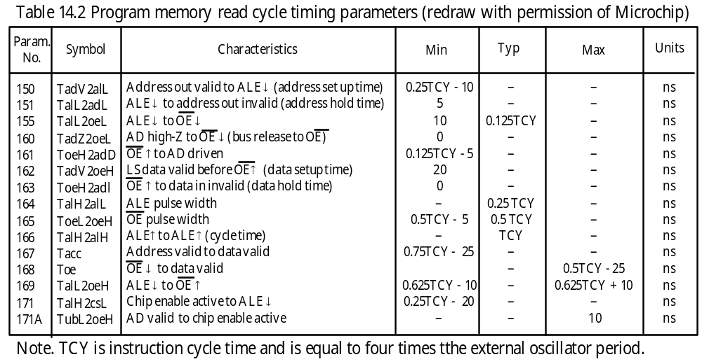

Slide 39
Data Reads (Table Reads)
A program fetches data from the external program memory by executing a table- read instruction.
The signal transaction for a data read transaction is identical to the program read cycle.
The value of TBLPTR<20:1> appears on the address pins A<19:0>. The value of TBLPTR<20:1> appears on the address pins A<19:0>.
The TABPTR<0> bit is copied to BA0 pin.
Sixteen bits of data are driven onto (by the memory device) the data bus.
Circuitry in the TABLAT register will select either the high or the low byte of the data from the 16-bit bus, based on the least significant bit of the address.
When the BA0 signal is 0, the lower byte (D<7:0>) is selected; when the BA0 signal is 1, the upper byte (D<15:8>) is selected.

Slide 40
Important Data Read Timing parameters
1. Address set up time: time interval that AD<19:0> valid before the falling edge of ALE. This parameter is TadV2alL (0.25TCY – 10).
2. Address hold time: amount of time that AD<15:0> remain valid after the falling edge of ALE. This parameter is TalL2adL (5 ns).
3. Read data setup time: amount of time that data is valid before the rising edge of OE.
This parameter is TadV2oeH (20 ns).
4. Read data hold time: amount of time that data remains valid after the rising edge of OE. This parameter is ToeH2adl (0 ns).
5. Address access time: the delay from the moment that address signals are valid until data is driven by memory device. This parameter is Tacc (0.75TCY – 25 ns)

Slide 41
Data Writes (Table Writes)
The user program writes data into the external program memory by executing one of the table-write instructions.
When a table-write instruction is executed, the least significant bit of TBLPTR is copied to the BA0 pin and the values of TBLPTR<20:1> appear on the address pins A<19:0>.
Depending on the external memory interface mode and the TBLPTR address, identical or different data may appear on the upper byte and the lower byte of the data bus.
The timing diagram for a data write cycle is shown in Figure 14.14.
Important Write Timing Parameters
1. Address setup and hold times relative to the ALE signal
2. Write pulse width: the duration that either WRH or WRL is low. This parameter is Twrl (0.5TCY – 5ns)
3. Write data setup time: the amount of time that the PIC18 drives data on the data bus before the rising edge of the WRH (or WRL). This parameter is TadV2wrL (0.5TCY – 10 ns).
4. Write data hold time: the amount of time that the PIC18 keeps the write data valid after the WRH (or WRL) has gone high. This parameter is TwrH2adl (5 ns).

Slide 42
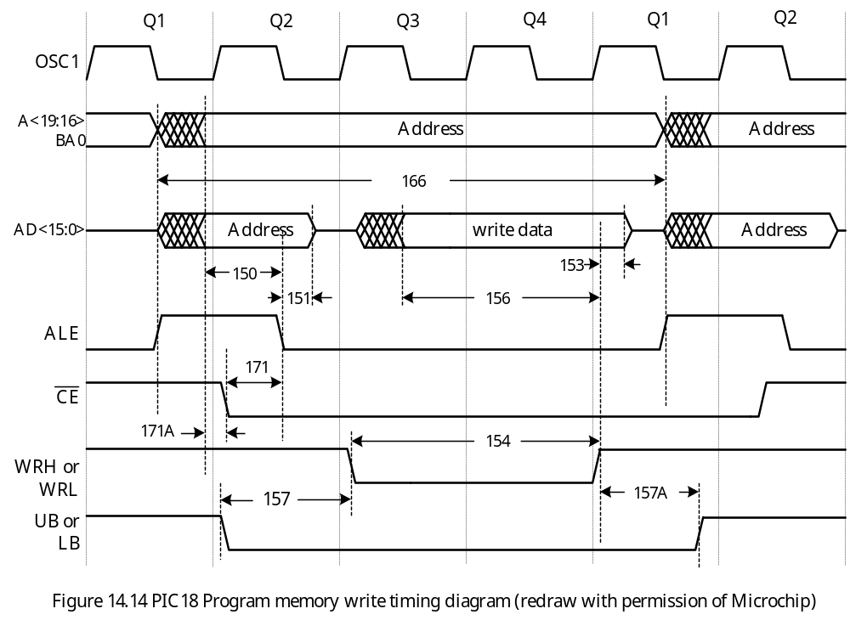

Slide 43
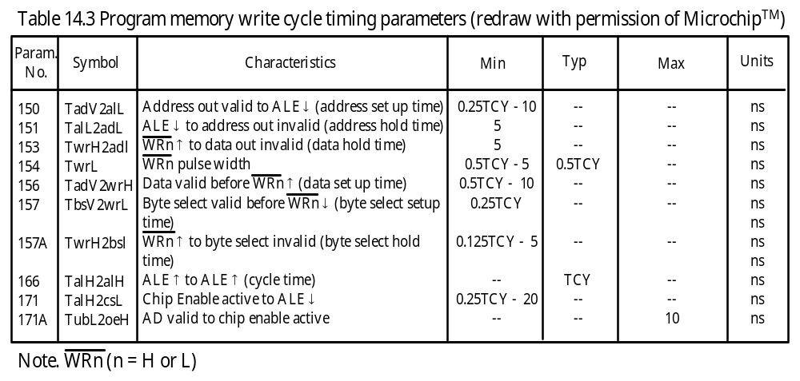

Slide 44
16-Bit EMI Operating Modes
Defined by the least significant 2 bits of the MEMCON register.
The setting of the EMI mode dictates the appropriate types of external memory available and the method for connection.
Word-Write Mode
This mode is used for 16-bit wide (i.e., in one location) memories that include some of the EPROM and FLASH type memories.
When a table write instruction writes to an even address (TBLPTR<0> = 0), the TABLAT data is transferred to a holding latch (referred to as TABLAT(0)) and the external address data bus changes to high-impedance state.
When a table-write instruction writes to an odd address (TBLPTR<0> = 1), the TABLAT data is driven on the upper byte of the AD<15:0> bus.
At the same time, the contents of the holding latch are presented on the lower byte of the AD<15:0> bus.
The signal is strobed for one write cycle; the signal is not used.
Both the UB and LB signals are active low to select these two bytes.
This method requires that table-write operation be performed in a pair on a word boundary in order to correctly write to a memory word.
An example is shown in Figure 14.15.

Slide 45
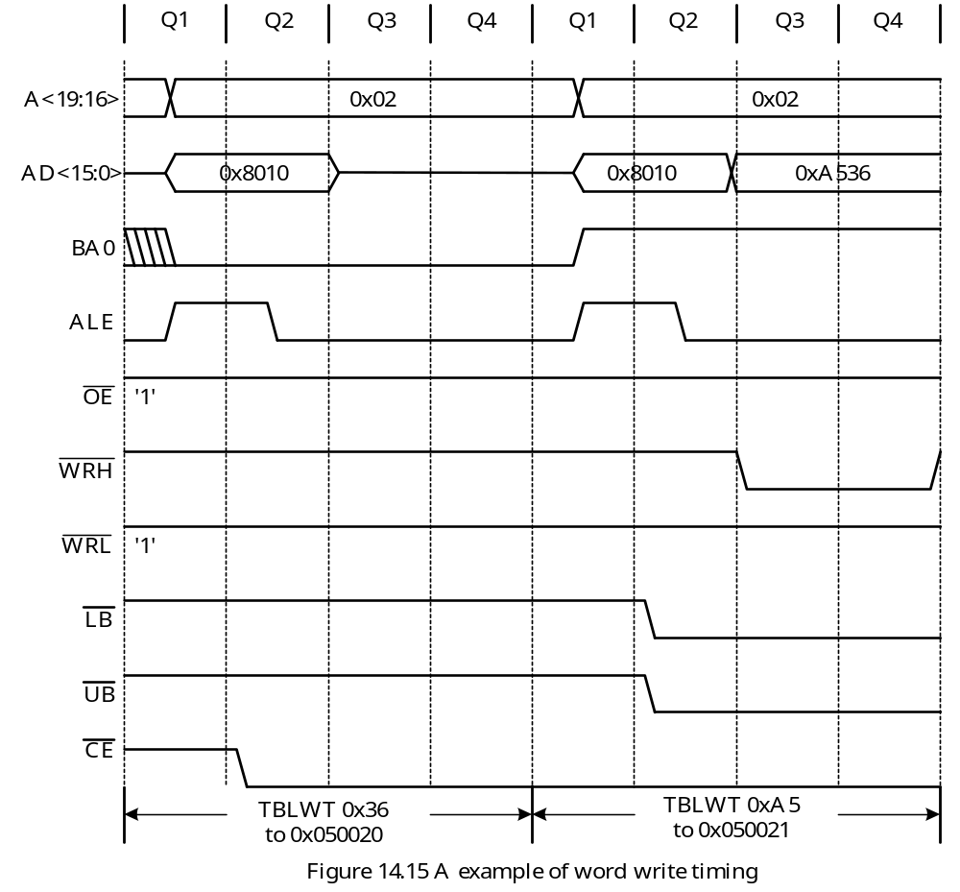

Slide 46
Byte Select Mode
Allows one to use table write instruction to write into a byte of a 16-bit wide external memory (one memory location has 16 bits) with byte selection capability.
When a TBLWT instruction is executed, the contents of the TABLAT register are driven on both the upper and lower bytes of the AD<15:0> bus.
The WRH signal is pulsed in each write cycle whereas the WRL signal is not used.
Either the BA0 or the UB/LB signal is used to select the byte to be written based on the least significant bit of the TBLPTR register.
An example is shown in Figure 14.16.
The least significant address bit is not included in A<19:0>.
After dropping the least significant bit, the value appears on A<19:0> becomes 0x049230.

Slide 47
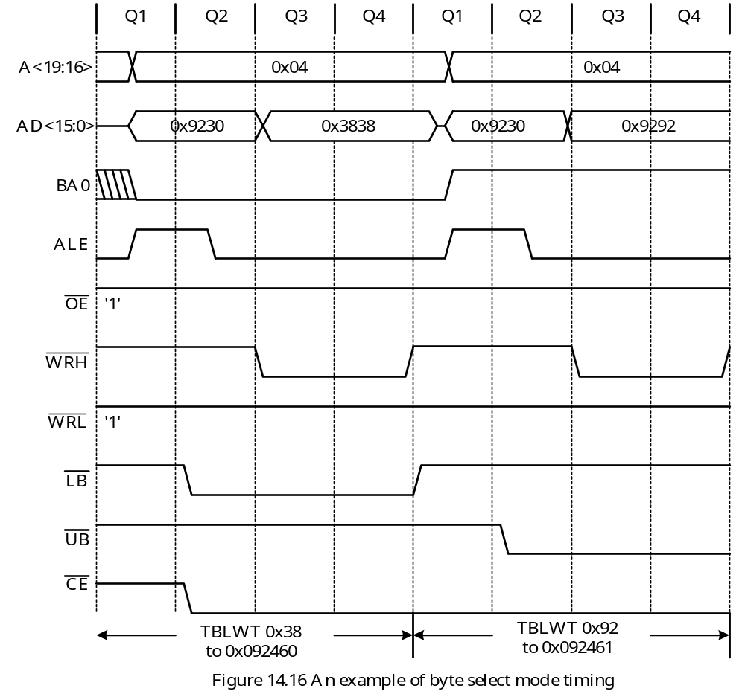

Slide 48
Byte Write Mode
This mode is used for two separate 8-bit wide memories (each location has 8 bits) connected for 16-bit operation.
When a TBLWT instruction is executed, the TABLAT data is driven on both the upper and the lower bytes of the AD<15:0> bus.
If the bit 0 of TBLPTR is 1, the signal is asserted. Otherwise the control signal is pulsed.

Slide 49
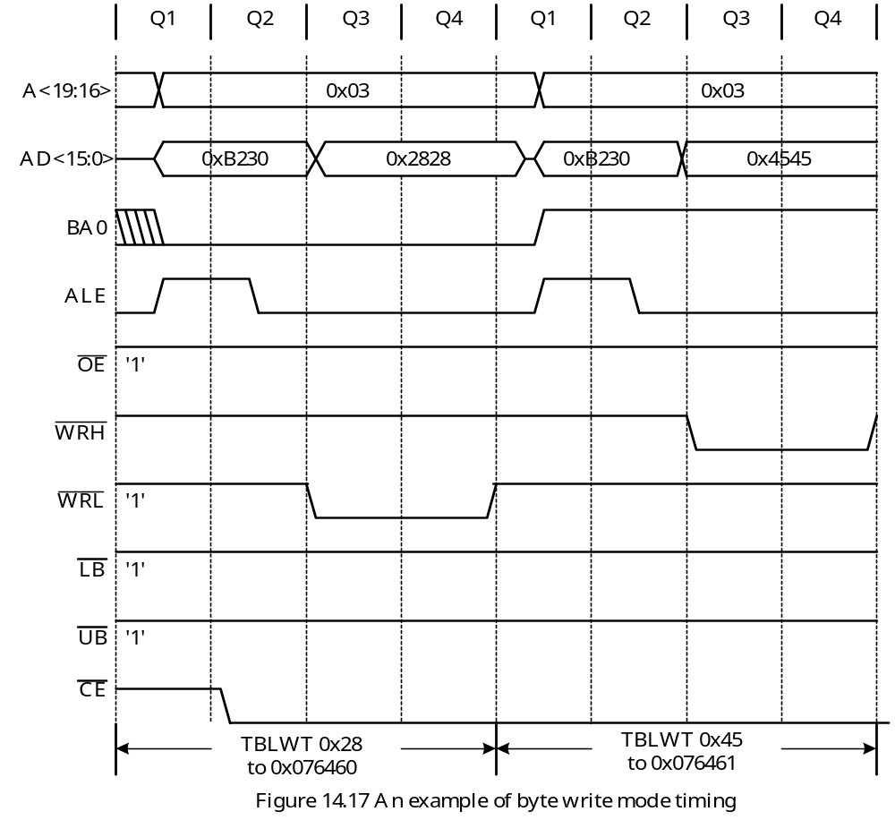

Slide 50
Wait States
The user can choose to add up to three instruction cycles to the table read or the table write cycle.
Figure 14.18 shows the timing diagram in which one wait state is added to a read cycle.
In this Figure, the CE and OE signals, once go low, will stay low until the end of the read bus cycle.

Slide 51
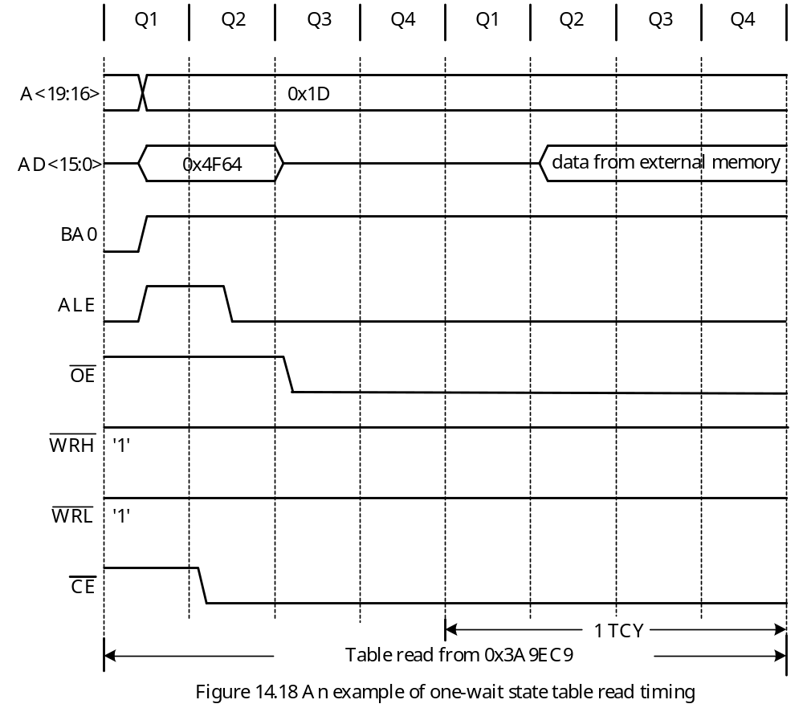

Slide 52
Issues Related to Adding External Memory
Memory space assignment
Address decoder and control circuitry design
Timing verification
Memory Space Assignment
Equal size assignment
1. The available memory space is divided into blocks of equal size.
2. Each block is assigned to a memory device without regard for the actual size of each memory-mapped device.
3. Memory space tends to be wasted using this approach because most memory- mapped peripheral chips need only a few bytes to be assigned to their internal registers.
Demand assignment
1. The user assigns the memory space according to the size of memory devices.

Slide 53
Example 14.2 Suppose a designer is assigned to design a PIC18F8680-based embedded product that requires 512 KB of external 16-bit SRAM, 256KB of 16-bit EEPROM (used to hold a constant table), and a parallel peripheral interface (PPI) that requires only four bytes of address space. The only available SRAM to this designer is the 128K × 8 SRAM chips (This chip has 128K locations with each location containing 8 bits). The only available EEPROM is the 128K × 8 EEPROM chips. Suggest a workable memory space assignment.
Solution:
Two 8-bit wide memory chips are needed to construct a 16-bit memory module.
Two 16-bit wide SRAM modules are needed to provide the 512 KB capacity.
One 16-bit wide EEPROM module is needed to offer the 256KB capacity.
A possible assignment is as follows:
SRAM0: 0x040000~0x07FFFF ; 256KB
SRAM2: 0x080000~0x0BFFFF ; 256KB
EEPROM: 0x0C0000~0x0FFFFF ; 256KB
PPI: 0x1FFFFC~0x1FFFFF ; 4 bytes

Slide 54
Address Decoder Design
- Select one and only one memory device to respond to the memory access request.
All memory devices have control signals such as chip-enable (CE), chip-select (CS), or output-enable (OE) to control their read and write operations.
Two address-decoding schemes have been used:
1. Full decoding
2. Partial decoding
Address decoder design is closely related to memory space assignment.
The programmable logic devices (PLDs) make full decoding easy and flexible.
GALs and PALs are often used to implement address decoders.

Slide 55
Timing Verification
In a read cycle, the most critical timing requirements are the data setup time and data hold time required by the microcontroller.
The address setup time and hold time requirements for the memory devices are also critical.
In a write cycle, the most critical timing requirements are the write data setup time and write data hold time required by the memory device.
The address setup time and hold time must also be satisfied.
For a write cycle, the write pulse width must be long enough for the write cycle to be successful.

Slide 56
Memory Devices
- The control circuit designs for interfacing the SRAM, the EPROM, the EEPROM, and the FLASH memory to the PIC18 MCU are quite similar.
The CY7C1019
A 128K × 8 SRAM from Cypress that operates with 5V power supply.
Has short access time in the range from 10 ns to 15 ns.
Has automatic power-down feature to reduce power consumption
The address signals A16-A0 select one of the 128K locations on the chip.
The CE signal enables read/write access to the CY7C1019.
The OE signal is the output enable. If OE is high, I/O pins will be in high- impedance.
Depending on the assertion times of control signals, there are two timing diagrams for the read cycle and three timing diagrams for the write cycle

Slide 57
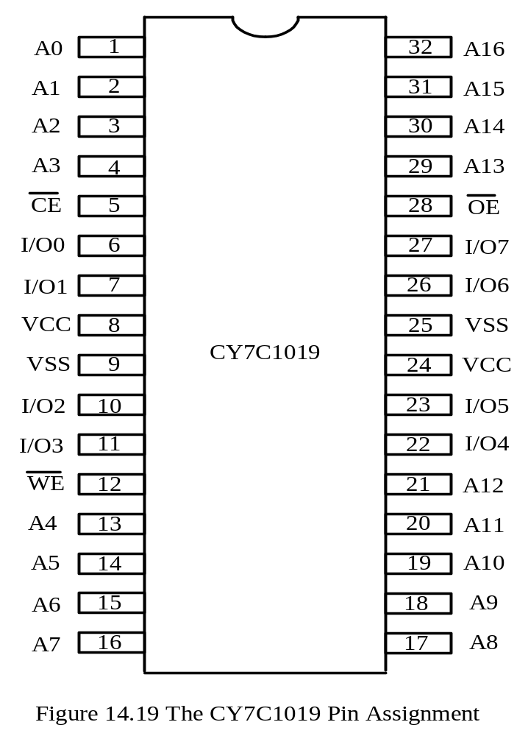

Slide 58
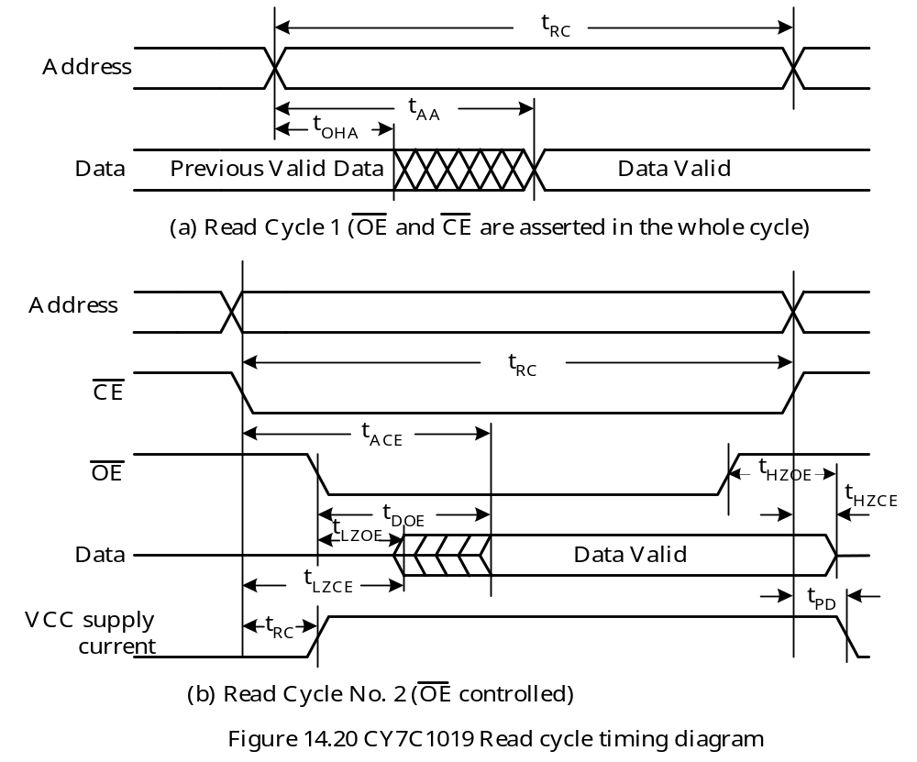

Slide 59
In Figure 14.20a and 14.20b, the CE signal must be asserted (low) for at least t_{RC} ns during a read cycle.
The signal that is asserted the latest determines the time that data will become valid.
In Figure 14.20b, the CE signal is asserted the latest, data becomes available t_{DOE} ns later.
Data pins will go to high-impedance state t_{HZOE} ns after the OE signal goes to high or t_{HZCE} ns after the CE signal goes to high.

Slide 60
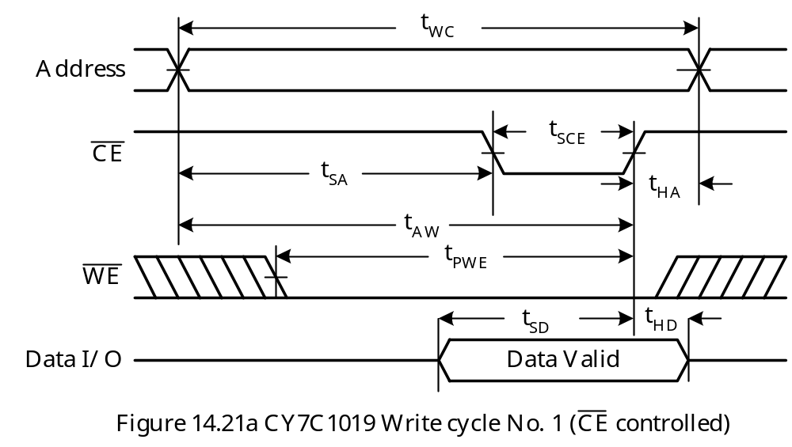

Slide 61
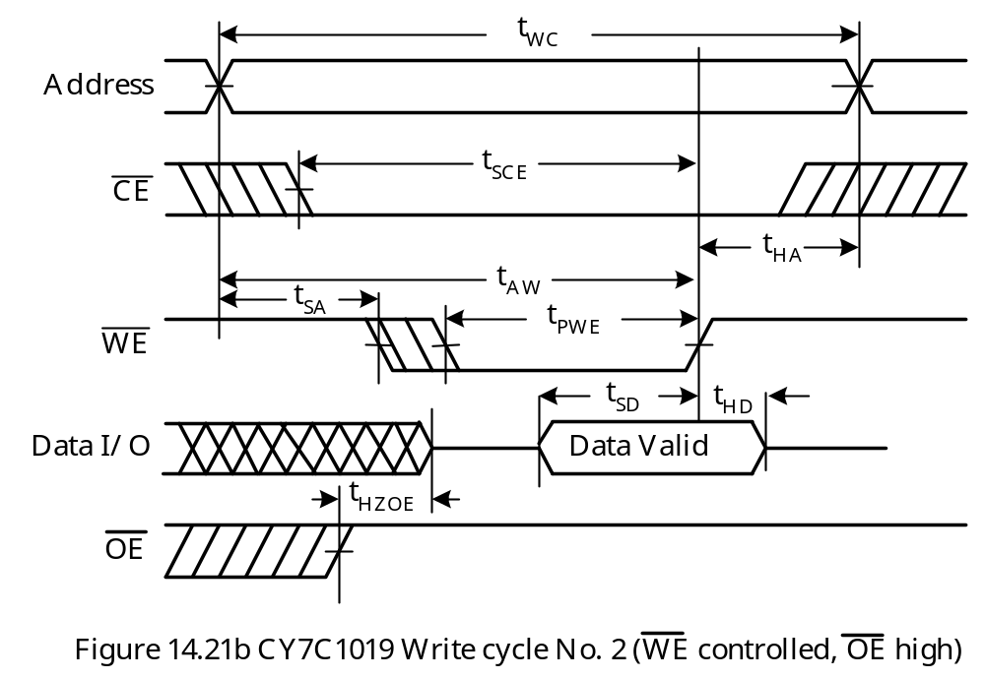

Slide 62
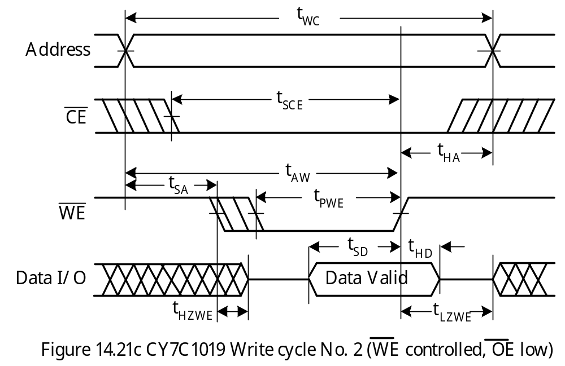

Slide 63
- The control signal that is asserted the latest controls the writing of the device.
In a CE-controlled write cycle, the CE signal is asserted after the WE signal.
1. The write pulse width (t_{PWE}) is measured from the moment that the WE signal goes low until the CE signal goes high.
2. The write data must be valid for t_{SD} ns before the CE signal goes high and remain valid for t_{HD} ns after the CE sigal goes high.
In a WE-controlled write cycle, the WE signal is asserted later than the CE signal.
1. The write data must be valid t_{SD} ns before the rising edge of the WE signal and must remain valid for t_{HD} ns after the rising edge of the WE signal.
2. The write pulse width is the duration that the WE signal is low.
- The parameter t_{SD} is the write data set up time whereas t_{HD} is the write data hold time.

Slide 64
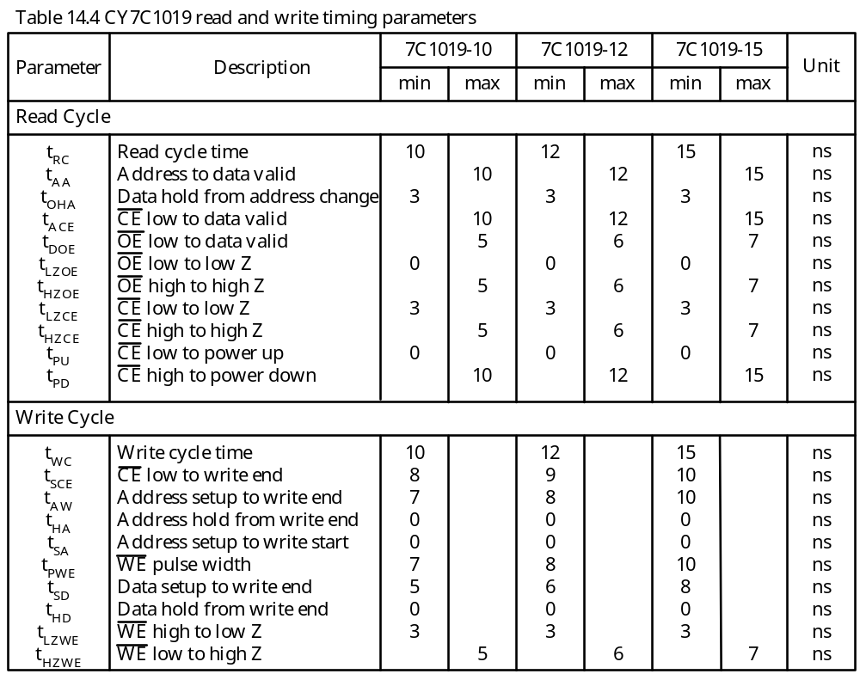

Slide 65
The AT28C010 EEPROM
- 128K × 8 capacity
Access time range from 120 ns to 200 ns.
Support the page-write feature that can write from 1 to 128 bytes.
Byte Write Operation
- Started by a low pulse on the WE input with the CE input being low and OE pin being high. Address input is latched on the falling edge of WE and data is latched on the rising edge of WE.
- Started by a low pulse on the CE input with the WE being low and OE being high. Address input is latched on the falling edge of CE and data is latched on the rising edge of CE.
Page-Write Operation
Started in the same manner as in byte write operation.
Each successive byte must be loaded within 150 μs (t_{BLC}) of the previous byte.
If the t_{BLC} limit is exceeded, the AT28C010 will cease accepting data and begin the internal programming operation.
All bytes involved in a page-write operation must reside on the same page as defined by the state of the A16-A7 inputs.
For each high-to-low transition of the signal during the page-write operation, the address signals A16-A7 must be the same.

Slide 66
Detecting the End of an Internal Write Operation
Poll the I/O7 pin.
Before internal write is complete, the I/O7 shows the complement of the value last written into it.
Successive attempts to read data from the device will result in I/O6 toggling between 1 and 0.
Data Protection
Both hardware and software features are provided to protect the memory against inadvertent write operations.
Hardware protection method:
1. VCC sense. If VCC is below 3.8V, the write function is inhibited.
2. VCC power on delay. Once VCC has reached 3.8V, the device will automatically time out for 5 ms before allowing a write operation.
3. Write inhibit. Holding the OE signal low, or the CE signal high, or the WE signal high inhibits write cycles.
4. Noise filter. Pulses of less than 15 ns on the WE or the CE input will not initiate a write cycle.

Slide 67
Software Data Protection
Enabling method:
Step 1
Write the value of 0xAA to the memory location at 0x5555.
Step 2
Write the value of 0x55 to the memory location at 0x2AAA.
Step 3
Write the value of 0xA0 to the memory location at 0x5555. At the end of write, write
protect state will be activated. After this step, write operation is also enabled.
Step 4
Write any value to any location (1 to 128 bytes of data are written).
Step 5
Write last byte to last address.

Slide 68
Disabling Method
Step 1
Write the value of 0xAA to the memory location at 0x5555.
Step 2
Write the value of 0x55 to the memory location at 0x2AAA.
Step 3
Write the value of 0x80 to the memory location at 0x5555.
Step 4
Write the value of 0xAA to the memory location at 0x5555.
Step 5
Write the value of 0x55 to the memory location at 0x2AAA.
Step 6
Write the value of 0x20 to the memory location at 0x5555. After this step, software data
protection is exited.
Step 7
Write any value (s) to any location (s).
Step 8
Write last byte to last address.

Slide 69
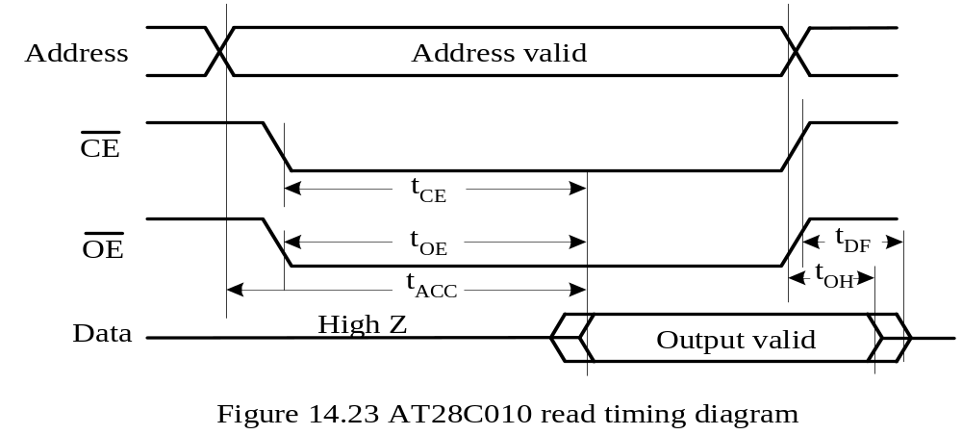
Read and Writing Timing
Three Read Access Times
Address access time t_{ACC}
CE access time t_{CE}
OE access time t_{OE}

Slide 70
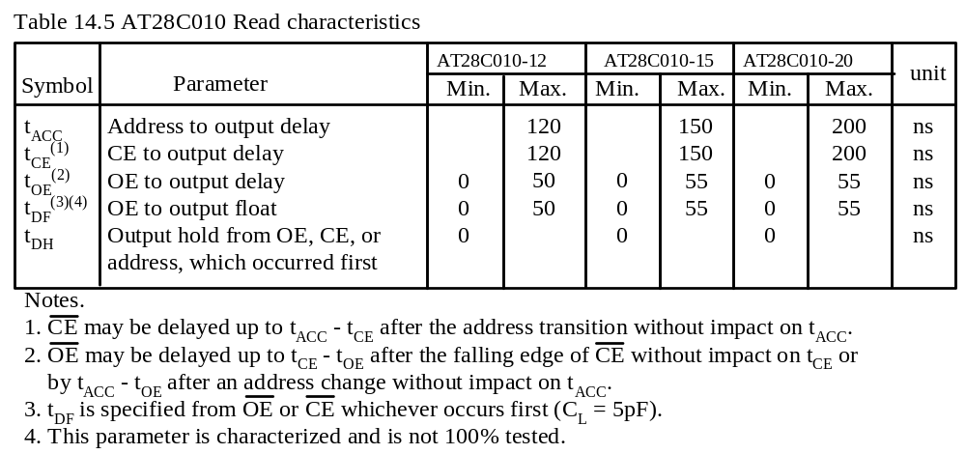

Slide 71
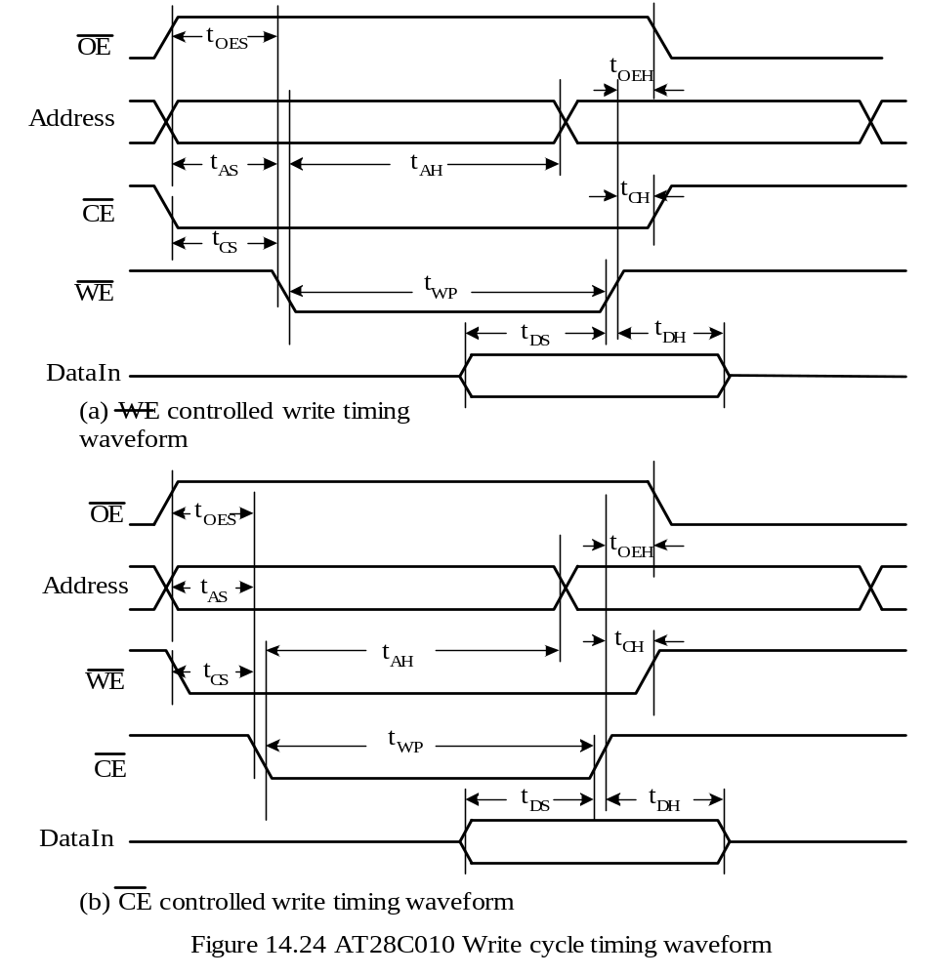
Two Write Timing
WE-control
CE-control

Slide 72
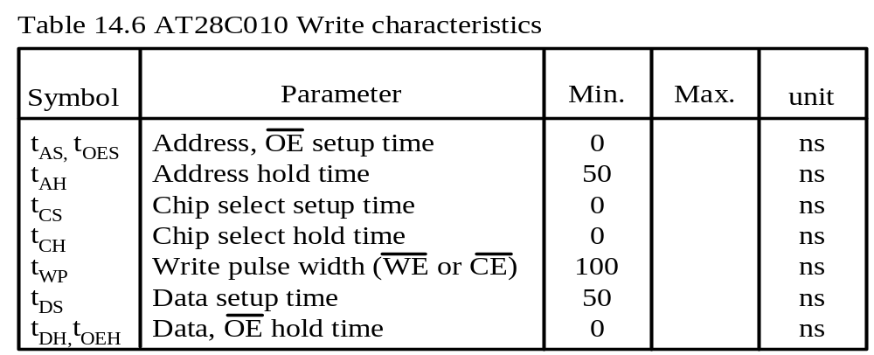
AT28C010 requires write data to be valid 50 ns before the rising edge of WE (or CE) and remains valid 0 ns after the rising edge of WE (or CE).

Slide 73
Example of External Memory Expansion for the PIC18
Design a demo board with 256 KB of 16-bit SRAM memory module and 256 KB of 16-bit EEPROM memory system.
Provide circuit and socket to add the second 256 KB 16-bit SRAM module.
Memory Space Assignment
SRAM module 0: 0x040000~0x07FFFF (the 2nd 256KB of the 2MB memory space)
SRAM module 1: 0x080000~0x0BFFFF (the 3rd 256KB of the 2MB memory space)
EEPROM module: 0x0C0000~0x0FFFFF (the 4th 256KB of the 2MB space)
Address Latch
Two 74HC573s (shown in Figure 14.27) are used to latch address signals A15~A0.
74HC573 requires the input setup time to be 15 ns and hold time to be 5 ns.
74HC573 has the typical and worst case propagation delays to be 15 ns and 28 ns.
Address signals A15-A0 (Q outputs of 74HC573) are valid 60.5 ns after the start of a bus cycle:
A<15:0> valid time = the delay of the rise edge of ALE from the start of Q1 +
+ pulse width of ALE – TadV2alL + t_{PHL}
= 22.5 ns + 40 ns – 30 ns + 28 ns
= 60.5 ns

Slide 74
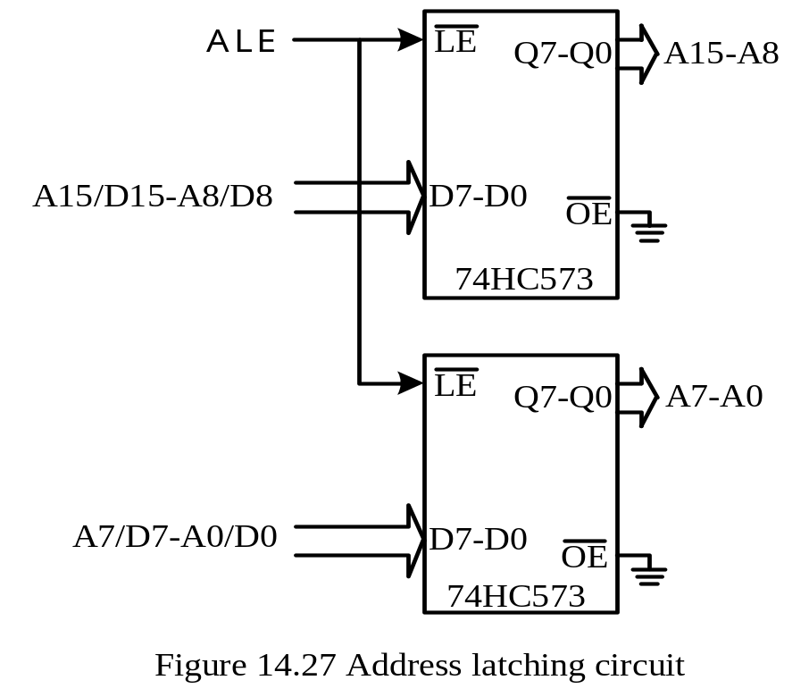

Slide 75
Address Decoder Design
Use a 74F138 as the decoder
Address signals A19-A17 will be decoded to select different memory modules.
The chip select signals are as follows:
CS_SRAM0 = !(!A19 * !A18 * A17 * CE)
CS_SRAM1 = !(!A19 * A18 * !A17 * CE)
CS_EEPROM = !(!A19 * A18 * A17 * CE)
CS4 = !(A19 * !A18 * !A17 * CE)
CS5 = !(A19 * !A18 * A17 * CE)
CS6 = !(A19 * A18 * !A17 * CE)
CS7 = !(A19 * A18 * A17 * CE)

Slide 76
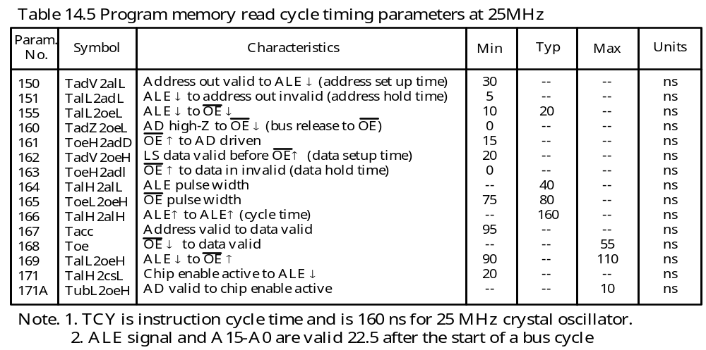
PIC18F8680 Timing Parameter Values at 25 MHz

Slide 77
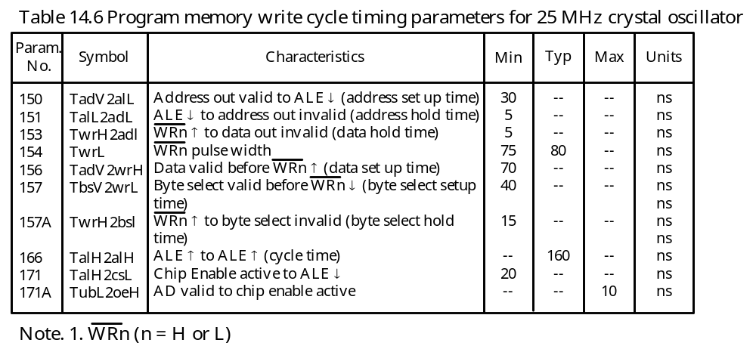

Slide 78
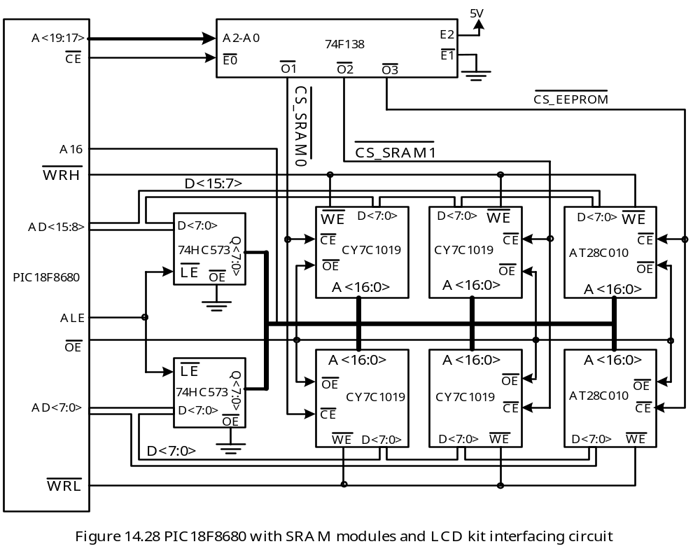
Example PIC18F8680 Demo Board Memory System Diagram

Slide 79
Example 14.3 For the circuit shown in Figure 14.28, verify that the read and write timing requirements for the PIC18F8680 are satisfied when accessing SRAM modules assuming that the PIC18F8680 is running with a 25 MHz crystal oscillator.
Solution:
Read Timing Analysis
The OE signal is valid (goes low) 75 ns before the end of the read cycle in no-wait state.
The CE input to the CY7C1019 is valid 31.5 ns after the start of a read cycle:
CE valid time = A<19:17> delay from start of us cycle + 74F138 prop. delay
= 22.5 ns + 9 ns = 31.5 ns.
OE becomes valid later than CE and hence determines the read access time.
Data becomes valid 60 ns (75 ns – 15 ns) before the end of the read cycle.
The required PIC18F8680 read data setup time is 20 ns and is satisfied.
The CY7C1019 holds data valid for 7 ns after OE goes high and satisfies the data hold time requirement (0 ns).
The resultant read-cycle timing diagram is shown in Figure 14.29.

Slide 80
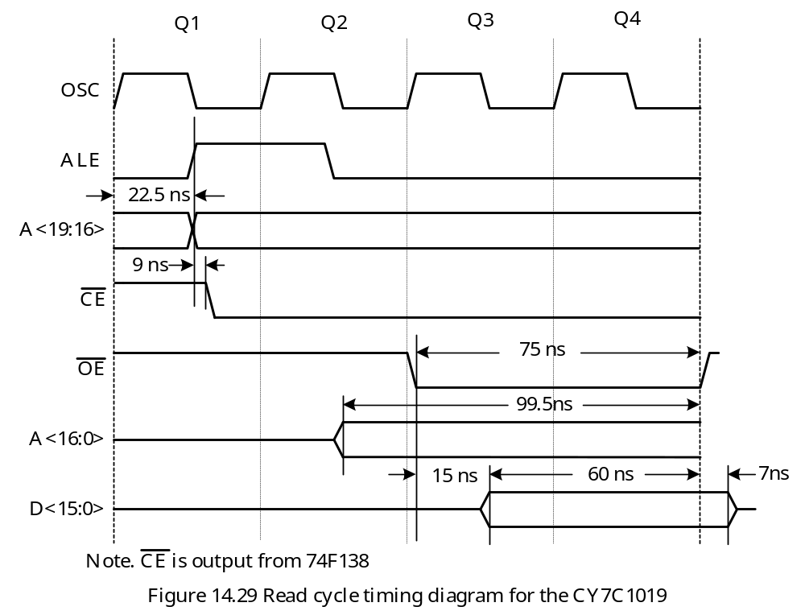

Slide 81
Write Timing Analysis
The WE signal is valid 75 ns before the end of the write cycle and hence is asserted later than the CE input.
The write cycle for this demo board is therefore WE-controlled.
Write data must be valid 8 ns before the rising edge of WE and remain valid for 0 ns after the rising edge of WE.
PIC18F8680 drives data onto the data bus 70 ns before the end of a write cycle and keeps it valid for 5 ns after the end of a write cycle.
Write cycle data setup time and hold time requirements are met.
The CY7C1019 requires WE pulse width to be at least 10 ns. The actual WE pulse width is 75 ns and hence is satisfied.
The resultant write-cycle timing diagram is shown in Figure 14.30.

Slide 82
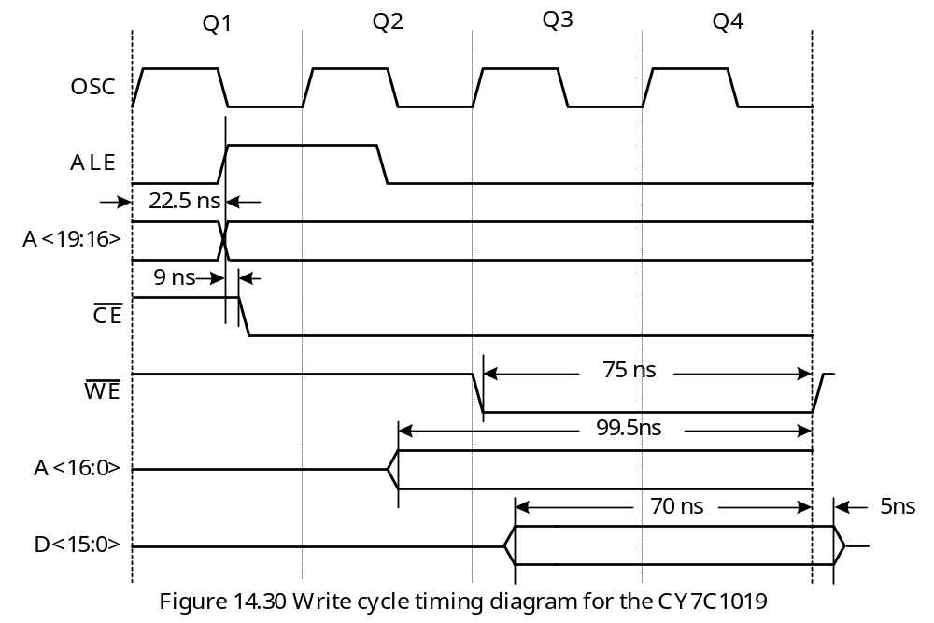

Slide 83
Example 14.4 Since the CY7C1019 is much faster than what is needed, what is the slowest memory that can be successfully accessed without wait states at 25 MHz?
Solution:
For a read cycle, the CY7C1019 is 40 ns (60ns – 20 ns) faster than required.
For a write cycle, the PIC18F8680 drives data 55 ns (70 ns – 15 ns) earlier than what is needed.
The slowest SRAM that can satisfy the timing requirements would have a read access time of 55 ns.
Most SRAM chips have very fast access times.

Slide 84
Example 14.5 Perform an analysis to decide the minimum number of wait states that are needed for the different versions of the AT28C010 EEPROM. Discuss the pros and cons between using flash memory and EERPOM in a system.
Solution:
Read Access Timing
Address signals A<16:0> are valid 99.5 ns before the end of a read cycle.
CE is valid 128.5 ns before the end of a read cycle.
OE is valid 75 ns before the end of a read cycle.
1. Using address access time. Read data from three versions of the EEPROM become valid 20.5 ns (120 – 99.5), 50.5 ns (150 – 99.5), and 100.5 ns (200 – 99.5) after the end of the read cycle.
2. Using the CE access time. Read data will become valid 8.5 ns before the end of a read cycle for 120 ns version, but will become valid 21.5 ns and 71.5 ns after the end of a read cycle for the 150 ns and 200 ns access time version.
3. Using the OE access time. Read data will be valid 25 ns, 20 ns, and 20 ns before the end of an instruction cycle for three versions of AT28C010, respectively.
Address access time is the dominant access time. Apparently, one wait state needs to be inserted. With one-wait state, the AT28C010 read data will become valid 139.5 ns, 109 ns, and 59.5 ns before the end of a read cycle.
AT28C010 provides 0 ns data hold and also meets requirement.

Slide 85
Write Cycle Timing
Write cycle is WE-controlled.
AT28C010 requires a write data setup time of 50 ns.
With no wait state, the PIC18F8680 drives write data 70 ns before the end of a write cycle. With one-wait state, this value is incremented to 230 ns and hence satisfies the requirement.
The PIC18F8680 keeps data valid 5 ns after the end of a write cycle and hence also satisfies the requirement of the AT28C010.
The required WE pulse width is 100 ns. The WE signal from PIC18F8680 is 235 ns (= 160 ns + 75 ns) and is satisfied.
AT28C010 requires address input to be valid 0 ns before the falling edge of WE and remains valid for 50 ns after the falling edge of WE.
A<16:0> become valid 99.5 ns before the end of the write cycle without wait state.
Therefore A<16:0> are valid 24.5 ns (99.5 – 75) before the falling edge of WE.
A<16:0> will stay valid 60.5 ns after a write cycle. This provides 295.5 ns of address hold.
All timing requirement are satisfied.

